Slide 1
SLAM POETRY
What is it, anyway?

Slide 2
Take A Guess...
What do you know or think you know about slam poetry?
What do you guess it might be?
Share your ideas.

Slide 3
Discovering Slam...Inductively
Take a handout from your teacher and read over the questions in each box.
As you watch some slam poetry performances, fill in the boxes to the best of your ability (there is no right or wrong!)
Your Goal: Figure out what slam poetry is all about by watching some of the "masters" at work.

Slide 4
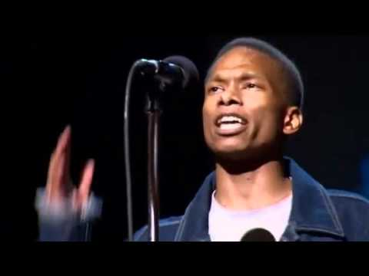
Slam #1: "Thinking About You"
If video above will not load, visit link: http://www.youtube.com/watch?v=P0QiFy8dmX0

Slide 5
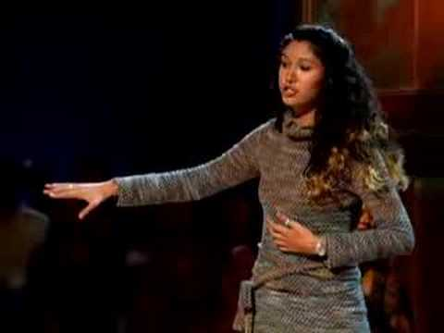
Slam #2: "Hands"
If video above will not load, visit link: http://www.youtube.com/watch?v=VuAbGJBvIVY

Slide 6
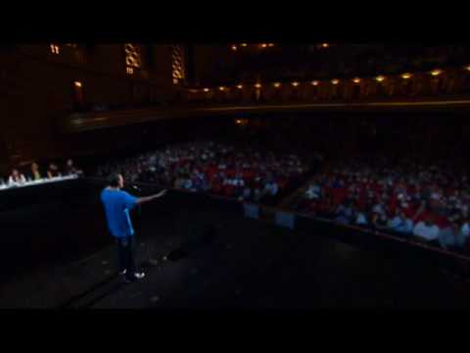
Slam #3: "Tourettes"
If video above will not load, visit link: http://www.youtube.com/watch?v=5eN_iXWCgzQ

Slide 7
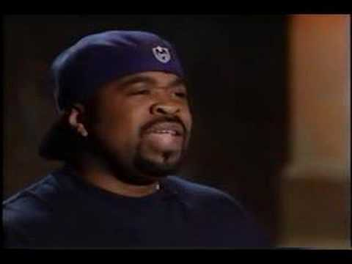
Slam #4: "Dating Myself"
If video above will not load, visit link: http://www.youtube.com/watch?v=UFhFaRKVpTY

Slide 8
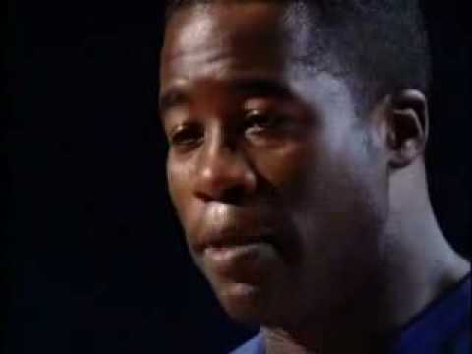
Slam #5: "Knock Knock"
If video above will not load, visit link: http://www.youtube.com/watch?v=9eYH0AFx6yI

Slide 9
Complete the Handout; Discuss
Now that you have seen several slam poems, you probably have a feel for what slam is all about.
Share/Discuss: How did you answer the questions in each box?

Slide 10
Try Your Hand at Slam
For the next few minutes, we will all take a shot at writing a slam poem.
Remember: It does not have to rhyme. It can be serious, or it can be funny. There are no real "rules" when it comes to writing slam poetry.

Slide 11
Potential Prompts:
You can write about anything you'd like, but if you need an idea, try one of these:
Write about a childhood game or memory. This could be about a parent, like the "Knock Knock" or "Hands" poem.
Taking inspiration from the "Tourettes" poem, write a poem about what makes you or someone you know different or unique.
Write a poem about what you think about when your mind wanders off in class, like the "Thinking About You" poem.
Write a "love poem" for something you dislike.

Slide 12
Share Your Slam with the Class

Slide 13
Want to See or Perform LIVE SLAM?
Come to the Youth Poetry Slam on Thursday, Nov.24th The slam is open to all high school students in the Littleton Public School District
Slam begins at 7:00 pm in the Arapahoe High auditorium
Tickets are $3 for students with valid I.D. from a Littleton Public School District high school; $5 for non-district guest
For more information or to sign up to perform, visit (write this down!):
LPSSLAM.weebly.com

Slide 14
Lesson Created by Holly Hoggarth, Smoky Hill High School April 2011

